Slide 1
Library of Quantum Machine Learning in myQLM
César Hernando de la Fuente
Quantum engineer intern

Slide 2
Overview
1
4
Introduction & Related Work
Quantum Circuit Born Machine
2
5
Proposals for myQLM
Conclusion & Outlook
3
Quantum Support Vector Machine

Slide 3
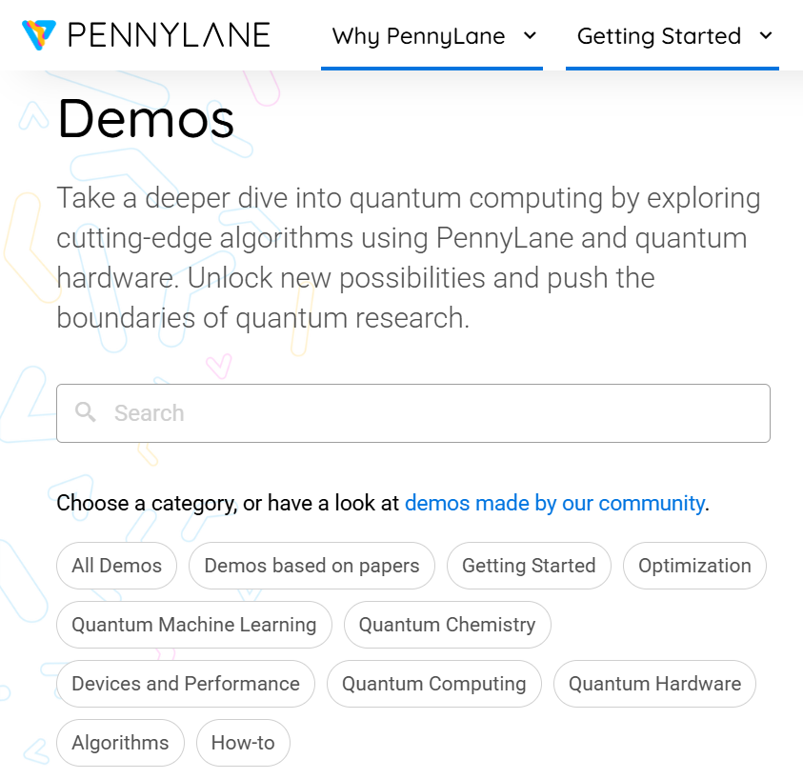
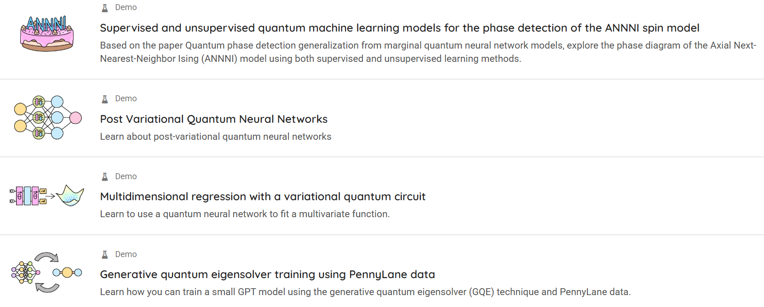
1. Introduction & Related Work
Quantum computing companies such as Xanadu, IBM and Google have already built Quantum Machine Learning (QML) libraries in their SDKs (Pennylane, Qiskit and Cirq) as well as Jupyter Notebook demos
https://pennylane.ai/qml/demonstrations

Slide 4
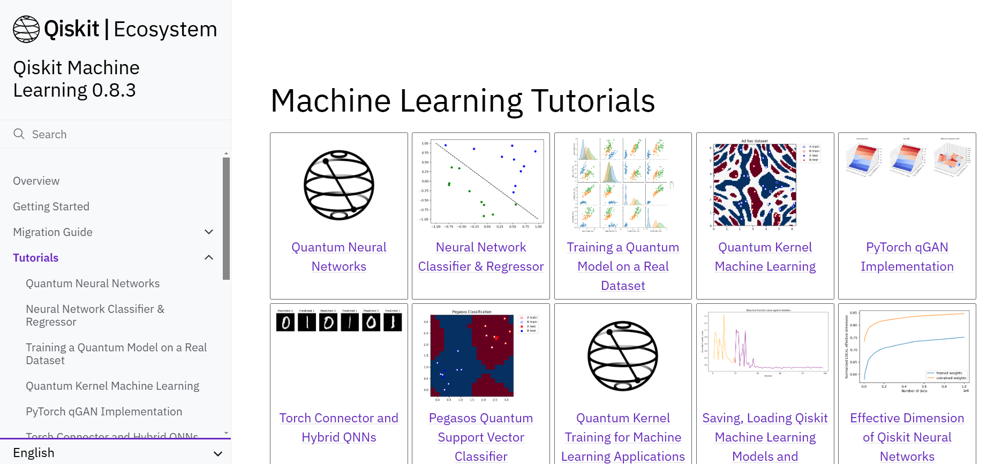
1. Introduction and related work
Quantum computing companies such as Xanadu, IBM and Google have already built Quantum Machine Learning (QML) libraries in their SDKs (Pennylane, Qiskit and Cirq) as well as Jupyter Notebook demos
https://qiskit-community.github.io/qiskit-machine-learning/tutorials/index.html

Slide 5
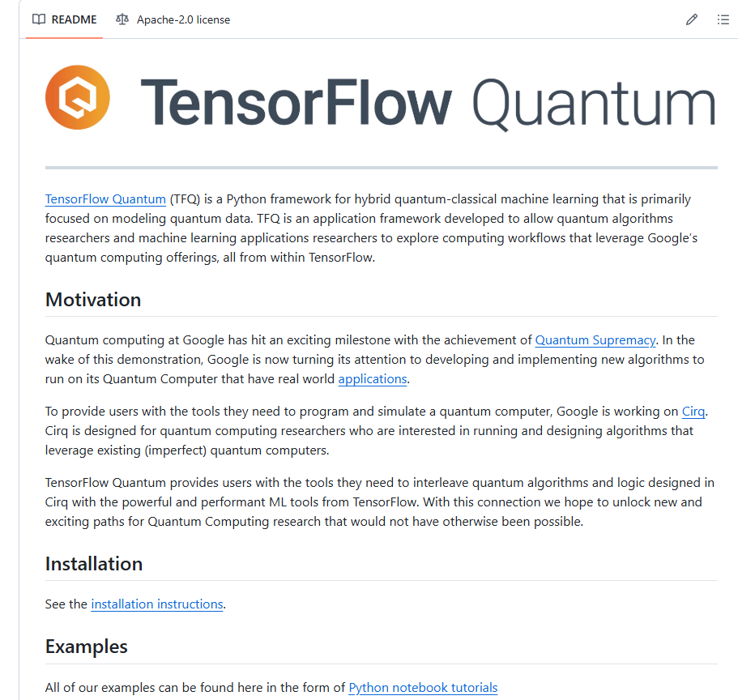
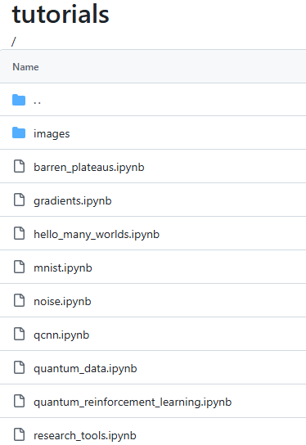
1. Introduction and related work
Quantum computing companies such as Xanadu, IBM and Google have already built Quantum Machine Learning (QML) libraries in their SDKs (Pennylane, Qiskit and Cirq) as well as Jupyter Notebook demos
https://github.com/tensorflow/quantum/tree/master/docs/tutorials

Slide 6
2. Proposals for myQLM
Implementing built-in QML algorithms in Atos & Eviden SKD myQLM would
Allow users to explore QML methods from a high-level perspective
Make myQLM more competitive with respect to other quantum programming languages
Enable the delivery of more advanced training modules in educational quantum computing workshops
Motivate the community, including researchers, to create and test their own QML algorithms, and develop demos which could be added to the official documentation website (https://myqlm.github.io/)

Slide 7
2. Proposals for myQLM
Some QML algorithms that could be added:
Quantum Support Vector Machine (QSVM)
Quantum Neural Networks / Parametrized Quantum Circuits (QNNs/PQCs)
Quantum Convolutional Neural Networks (QCNNs)
Quantum Circuit Born Machine (QCBM)
Quantum Generative Adversarial Networks (QGANs)
Quantum reinforcement learning
Supervised Learning
Unsupervised Learning
Reinforcement Learning

Slide 8
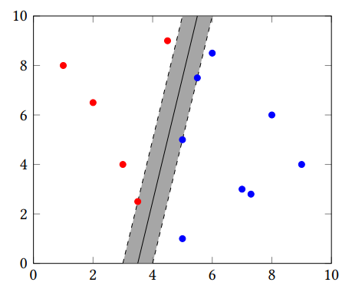

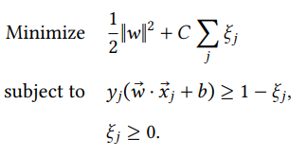

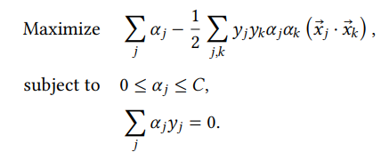

3. Quantum Support Vector Machine (QSVM)
Perhaps one of the simplest and easiest QML algorithm to implement
The idea in a nutshell:
Hard-margin
Soft-margin
Lagrangian dual problem
Convex quadratic programming problem
Solvable with Sequential Minimal Optimization (SMO)
Hyperplanes equations
Distance between hyperplanes
[1] Schuld & Killoran, A Practical Guide to Quantum
Machine Learning and Quantum Optimization
[2] Abu-Mostafa et al. Learning from Data, e-Ch. 8

Slide 9
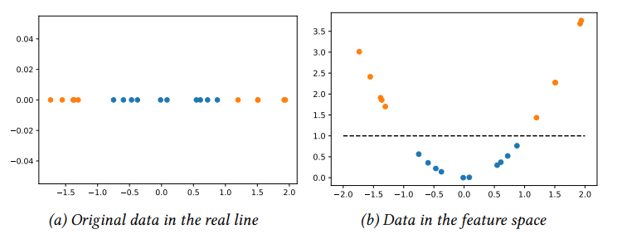


3. Quantum Support Vector Machine (QSVM)
With the current formulation, the algorithm could only be applied to problems where data is linearly separable
Solution: Kernel trick Map points x to points in a higher dimensional space, hoping that in that space (feature space) data can be separated linearly
$$φ: x\overset{→}{}φ(x)$$
[1] Schuld & Killoran, A Practical Guide to Quantum
Machine Learning and Quantum Optimization

Slide 10

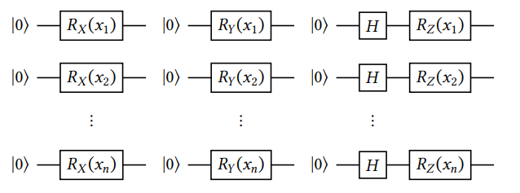
3. Quantum Support Vector Machine (QSVM)
Going Quantum: Map points x to quantum states
There are many different types of feature maps
I have started focusing on angle encoding
Other possibilities are amplitude encoding or ZZ Feature maps
The implementation of QSVM and an example notebook can be found in:
https://github.com/cesar-hernando/myQLM/tree/main/tutorials/quantum_machine_learning
Angle encoding
[1] Schuld & Killoran, A Practical Guide to Quantum
Machine Learning and Quantum Optimization

Slide 11
4. Next step: Quantum Circuit Born Machine
Some QML algorithms that could be added:
Quantum Support Vector Machine (QSVM)
Quantum Neural Networks / Parametrized Quantum Circuits (QNNs/PQCs)
Quantum Convolutional Neural Networks (QCNNs)
Quantum Circuit Born Machine (QCBM)
Quantum Generative Adversarial Networks (QGANs)
Quantum reinforcement learning
Supervised Learning
Unsupervised Learning
Reinforcement Learning

Slide 12
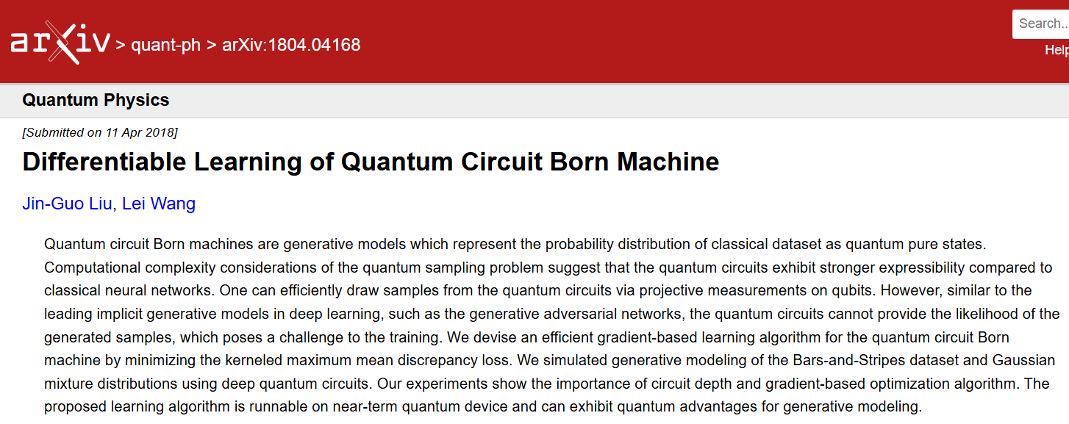
4. Next step: Quantum Circuit Born Machine
There are some reference papers about this quantum algorithm:
1
QuantumCircuitBornMachine/notebooks/qcbm_gaussian.ipynb at master · GiggleLiu/QuantumCircuitBornMachine · GitHub

Slide 13
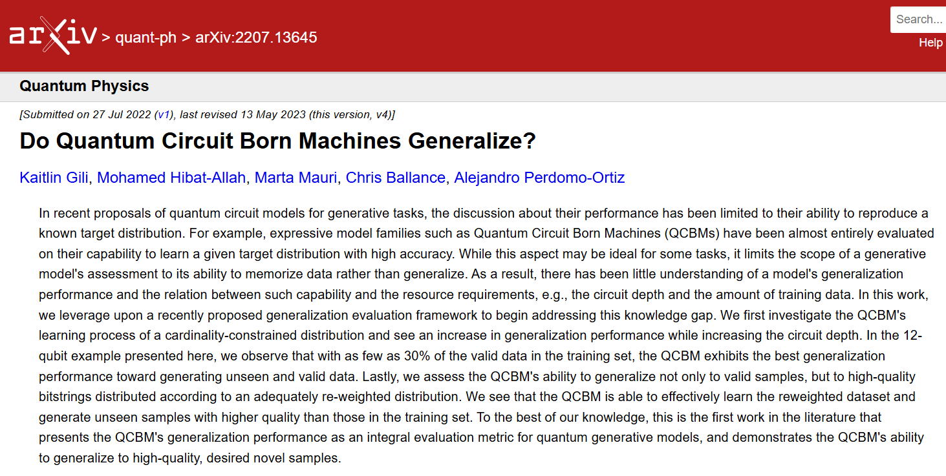
4. Next step: Quantum Circuit Born Machine
There are some reference papers about this quantum algorithm:
2

Slide 14

4. Next step: Quantum Circuit Born Machine
These papers will be discussed next week together with the implementation of QCBM in myQLM

Slide 15
For more information please contact: cesar.Hernando@atos.net

Slide 16
Questions

